Slide 1
YOLO-CFAR Reproduction-2
林郁庭(2021)。基於YOLO之雷達目標偵測演算法。國立清華大學通訊工程研究所碩士論文，新竹市。 取自 https://hdl.handle.net/11296/7n49t5
Advisor: Dr. Chih-Yu Wang
Presenter: Shao-Heng Chen
Date: July 13, 2022

Slide 2
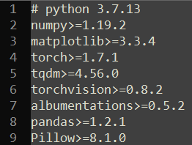
Objectives
1. Figure out how RD map data labeling works
2. Run YOLOv3 in PyTorch
– successfully run a minimal implementation of YOLOv3, only
around 800 lines of code
– minimum dependencies
1

Slide 3
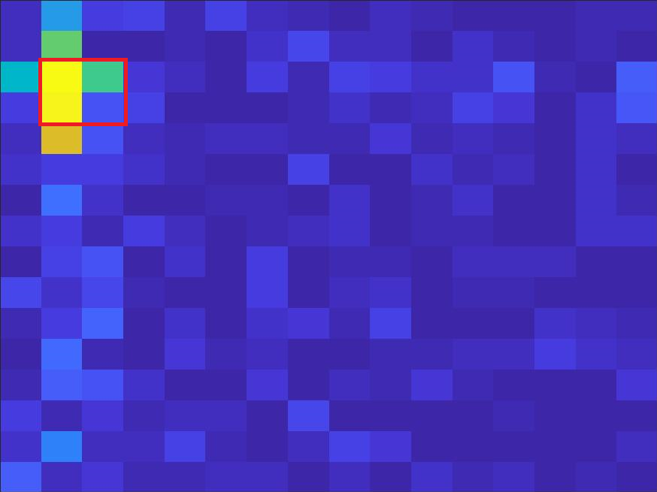
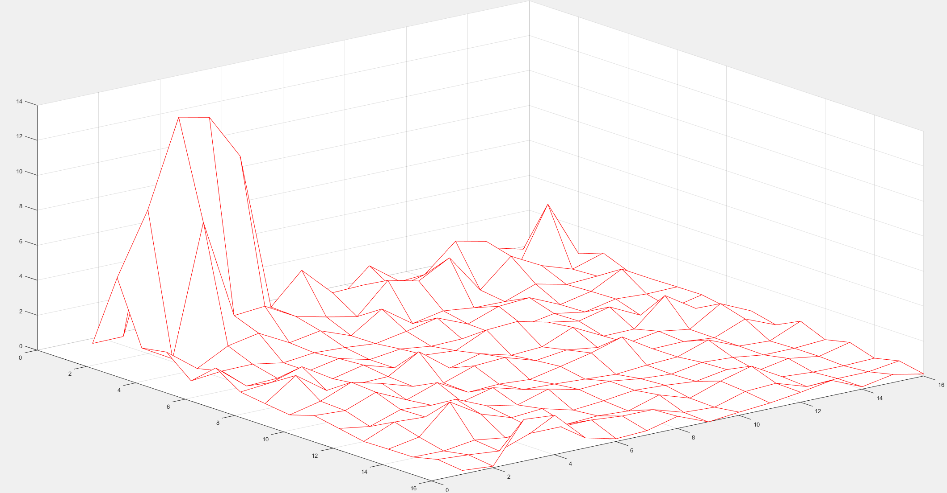
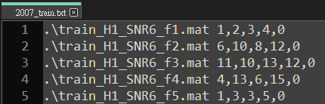
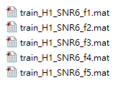
RD map
– e.g. \train_H1_SNR6_f1.mat (x_min, y_min), (x_max, y_max), label
2

Slide 4
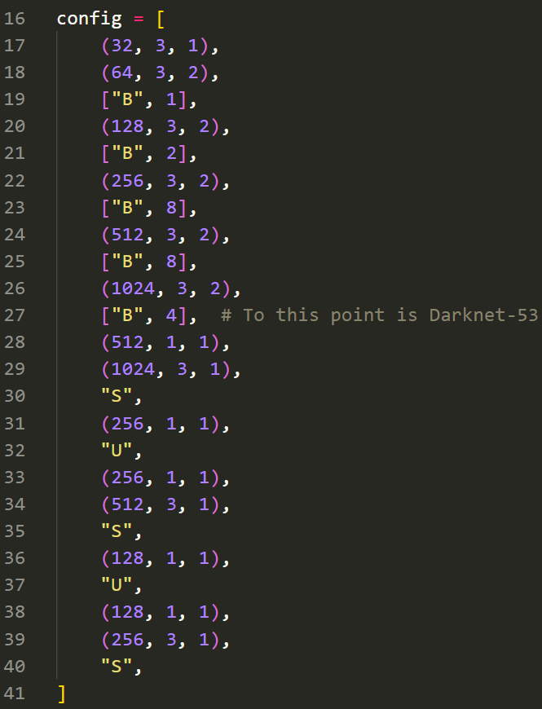
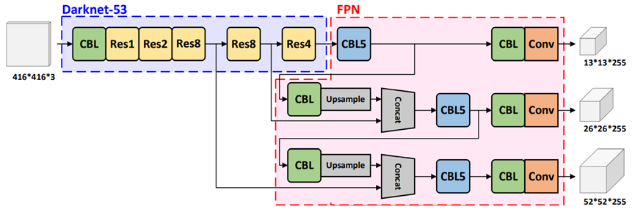
YOLOv3-PyTorch
– A minimal implementation of YOLOv3
– Can be trained in PASCAL VOC YOLO dataset [1]
– (filters, kernel_size, stride), every conv() are the same
[1] https://www.kaggle.com/datasets/aladdinpersson/pascal-voc-yolo-works-with-albumentations
3

Slide 5
Issues
1. Haven’t actually figure out how the data generation and labeling works
2. MATLAB simulation code have tons of problems
3. The annotation format are slightly different
– (x_min, y_min), (x_max, y_max), label vs. (x, y), (height, width), label
4

